Slide 1
PRODUCT REVIEW TAGGING
IQRAA SHAIKH

Slide 2
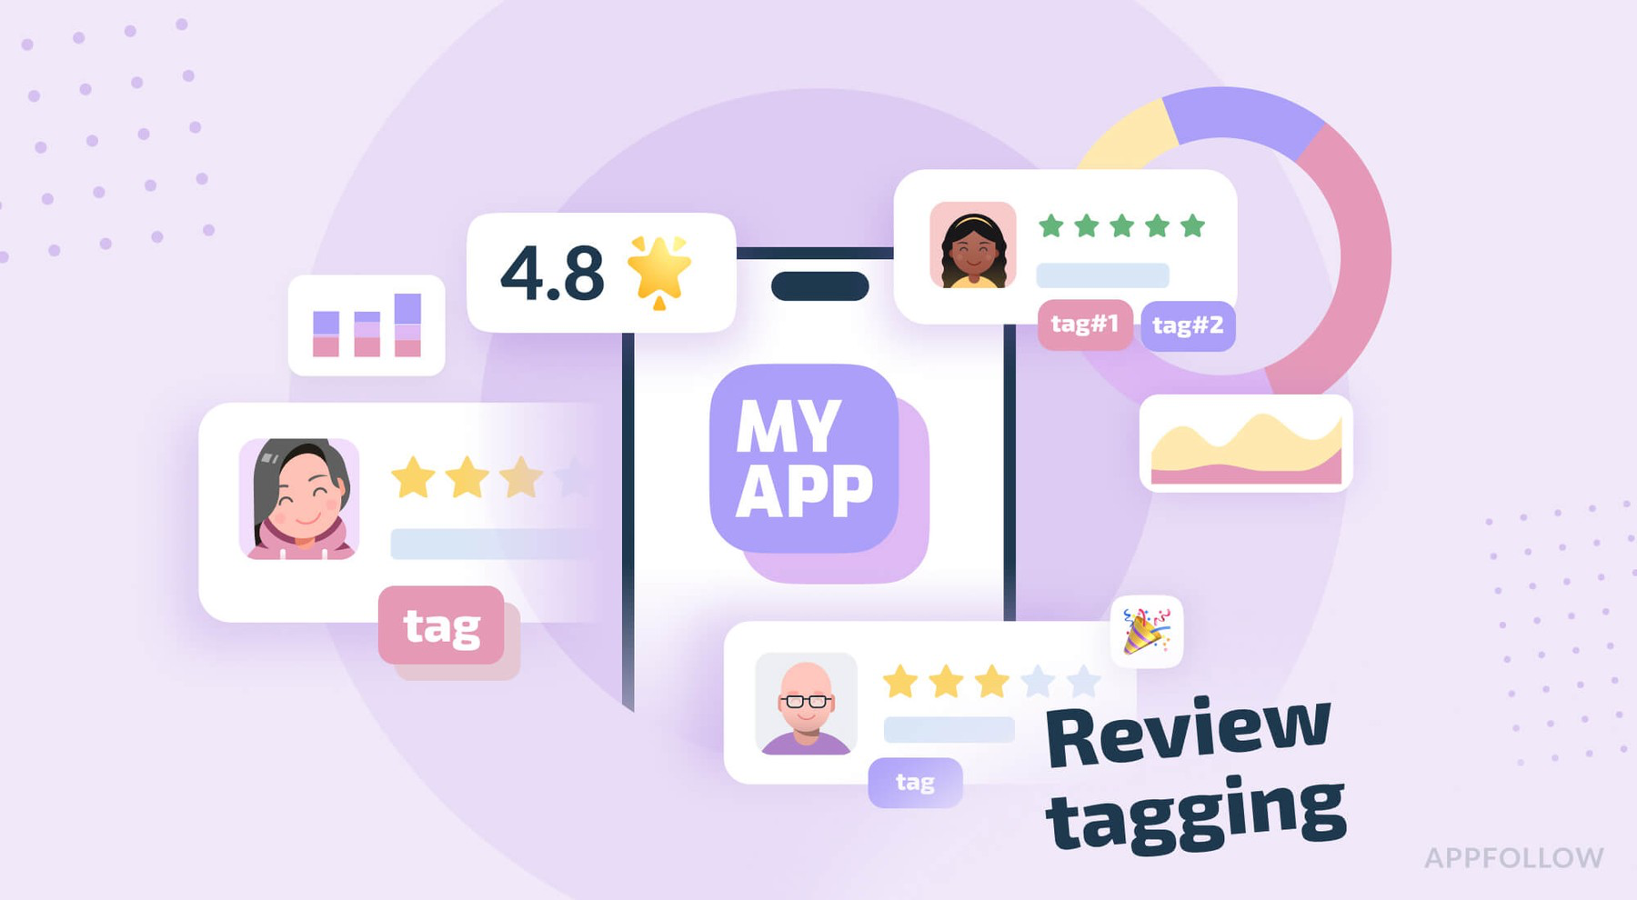
AGENDA:
E-commerce platforms receive millions of customer reviews daily. These reviews contain valuable feedback about product performance, delivery experience, packaging quality, and satisfaction levels. However, manually reading and interpreting such large volumes is time-consuming and inefficient.

Slide 3
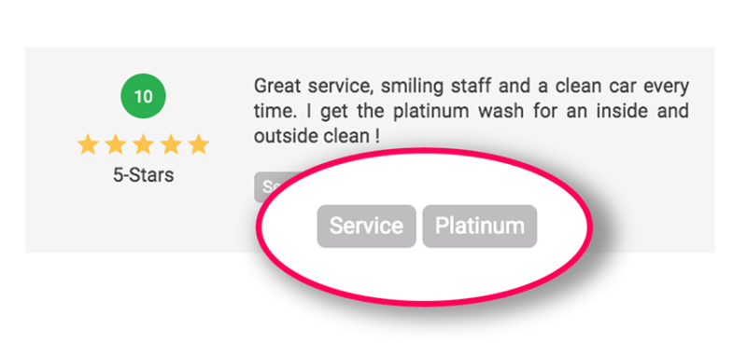
INTRODUCTION:
The objective of this project is to develop a rule-based Natural Language Processing (NLP) system that automatically identifies important feedback categories (tags) such as:
.Late Delivery
.Fast Delivery
.Battery Issue
.Good Packaging
.Bad Sound Quality

Slide 4
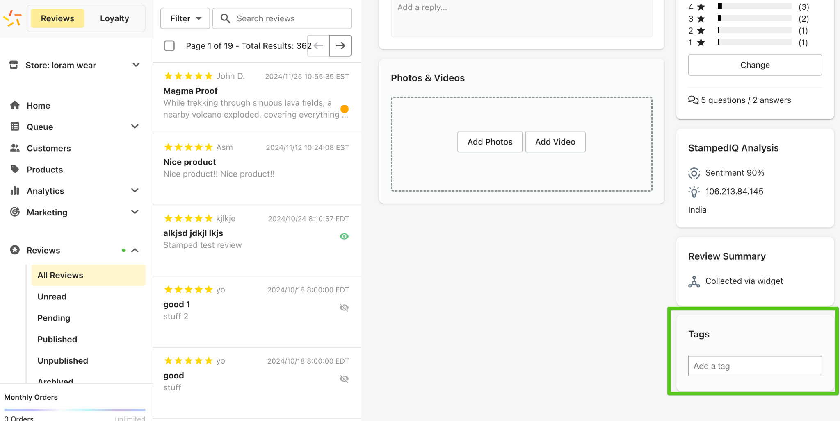
PROBLEM STATEMENT:
To design and implement a pattern-based NLP pipeline for automatically analyzing customer reviews and assigning predefined labels using a non-machine-learning, rule-driven approach without deep learning models.

Slide 5
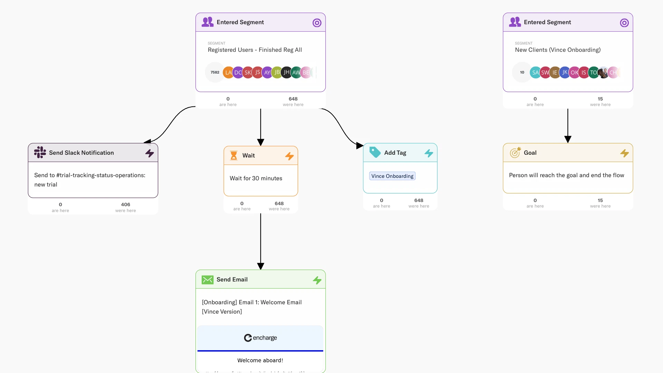
OBJECTIVES:
Automatically extract feature-level customer feedback from product reviews.
Identify multiple attribute tags per reviews.
Build configurable rule-based tag dictionaries for easy customization.
4. Provide structured tabular output for analytics.
5. To categorize reviews into predefined meaningful tags
(e.g., Delivery Issue, Battery Issue, Packaging, etc.)

Slide 6
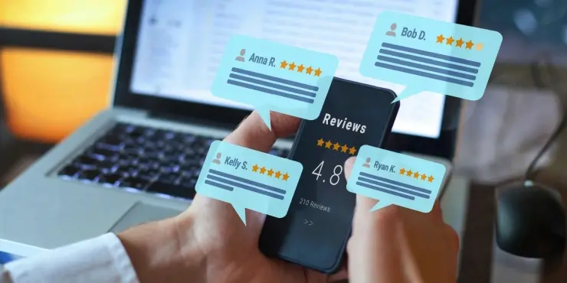
SCOPE OF THE PROJECT:
. Collect product reviews dataset
. Preprocess and clean the review text
. Apply rule-based phrase matching and
negation detection
. Generate predicted tags using the NLP
pipeline
. Evaluate results and generate analytics
visuals

Slide 7
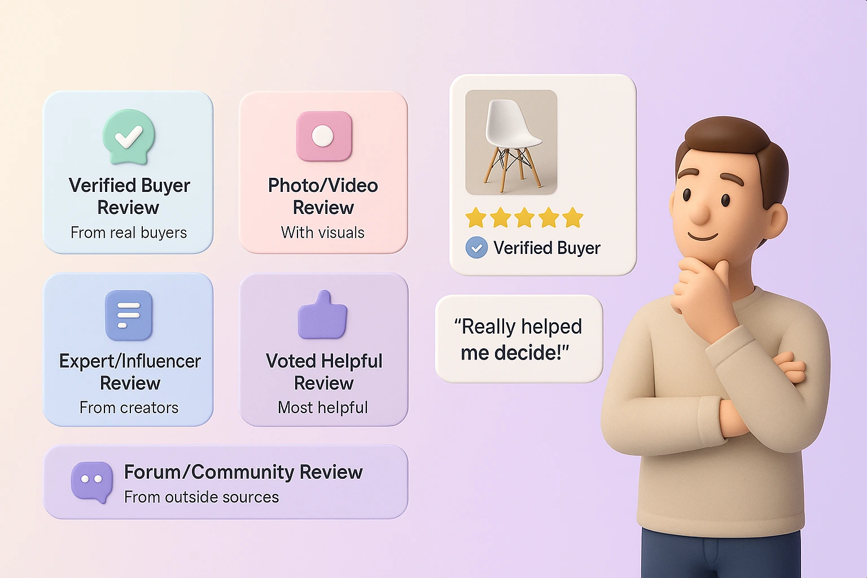
METHODOLOGY:
. Data Collection
. Text Preprocessing
(Tokenization, Cleaning, Stemming)
. Tag dictionary design
. Rule-based tagging using pattern matching
(Regex/spaCy PhraseMatcher)
. Evaluation and visualization

Slide 8


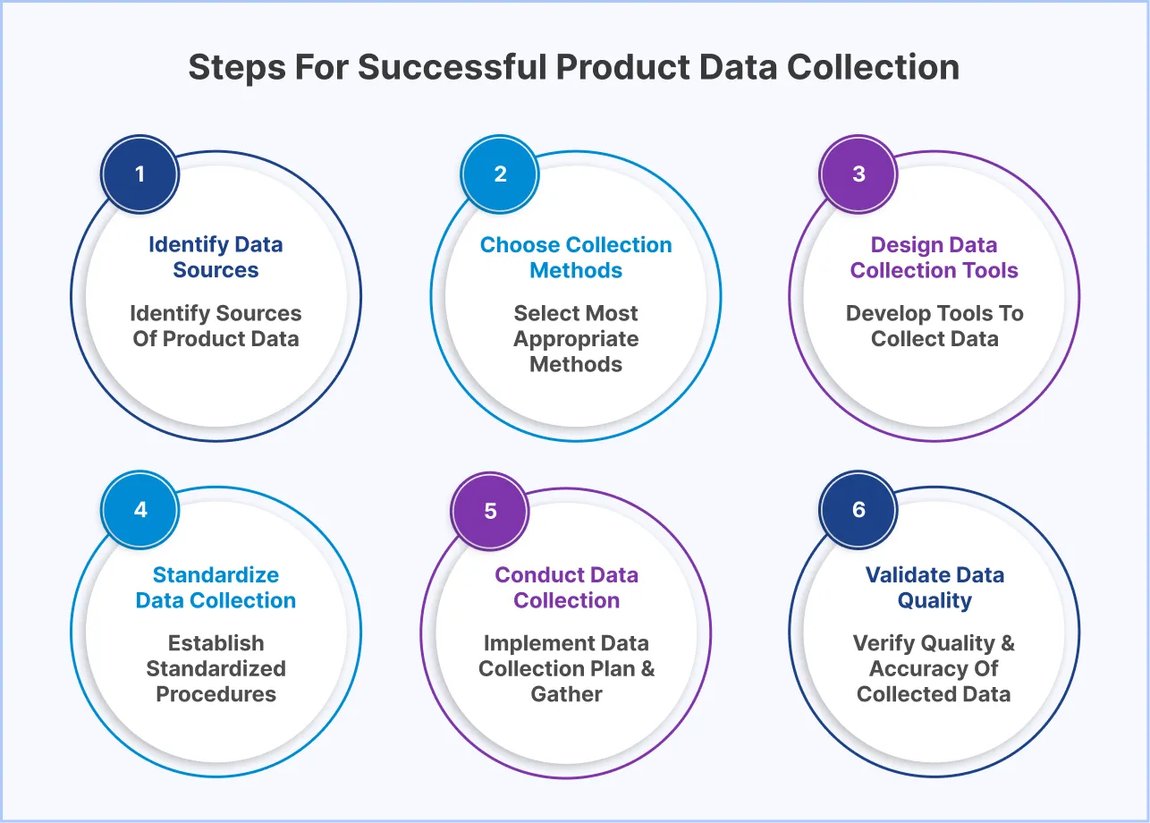
STEP 1: DATA COLLECTION
Source datasets:
.Public datasets such as Snapdeal Products Review API dataset
.Scraped reviews from Flipkart (limited to 1000 reviews with
beautifulSoup)
Collected fields:
.Review text
.Star rating

Slide 9
STEP 2: DATA PREPROCESSING
TASK DESCRIPTION
Lowercasing Standardize text
Remove punctuation Clean noise via regex
& emojis
Remove stop-words Words like the,is,was
Tokenization Splitting text into words
Stemming/Lemmatization Convert words to root form
Negation detection e.g., not good battery

Slide 10
STEP 3: TAG DICTIONARY CREATION
A JSON/CSV mapping of tags → keyword patterns and synonyms
Example:
TAG KEYWORDS
Late Delivery delayed, came late, took too long, shipment
delayed
Battery Issue battery drains, poor battery, dies quickly

Slide 11
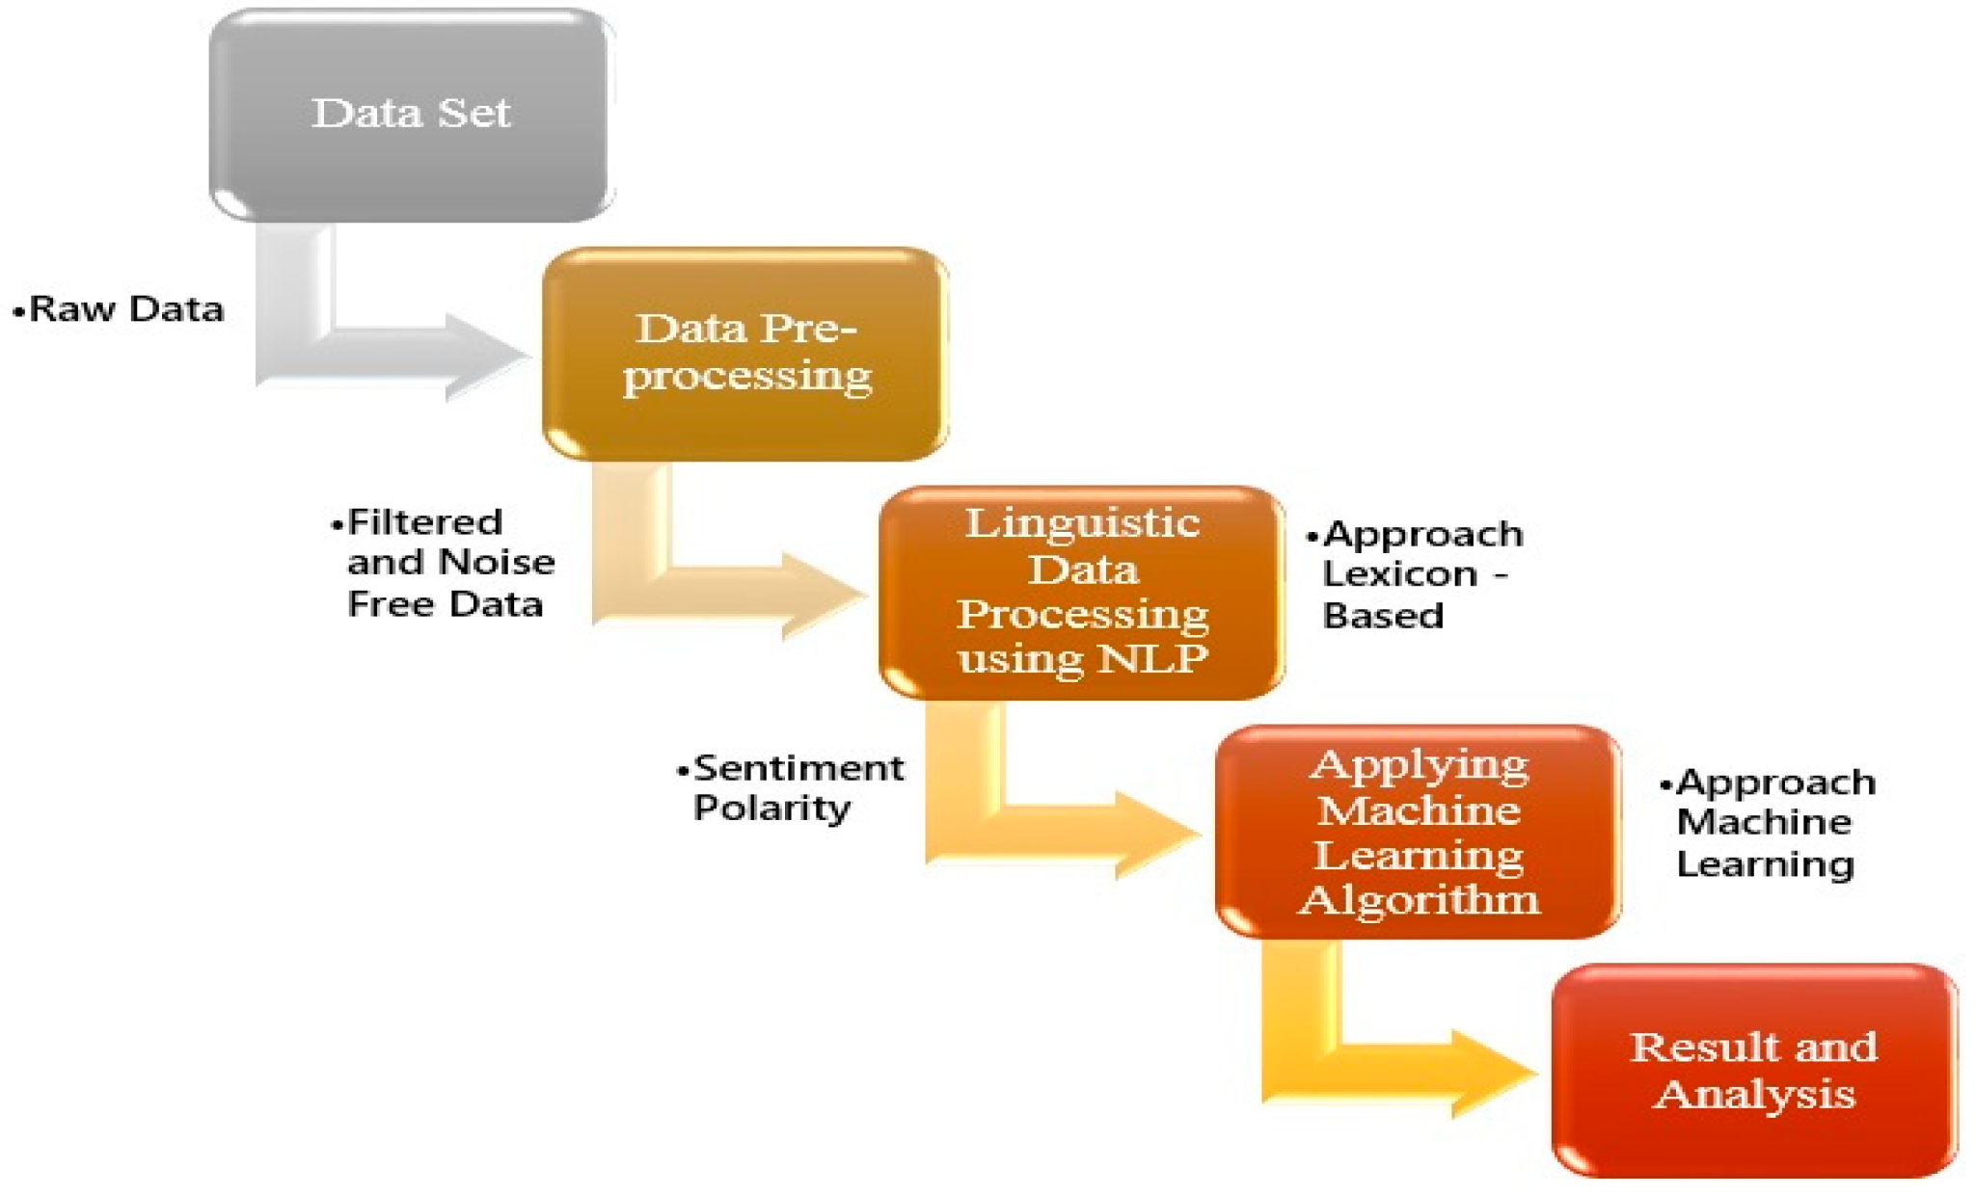
STEP 4: PATTERN BASED TAGGING
Using rules such as:
.PhraseMatcher (spaCy)
.Regular Expressions (regex pattern matching)
.Multi-label extraction
.Negation filtering:
.”Not a battery issue”→remove
battery issue tag

Slide 12
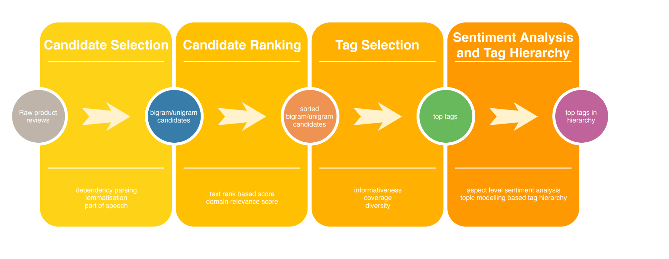
STEP 5: OUTPUT GENERATION:
. Structured format: CSV or JSON
. Columns: Review Text, Clean Review, Rating, Predicted Tags
. Visualization: Bar graph/Pie chart of tag frequency

Slide 13
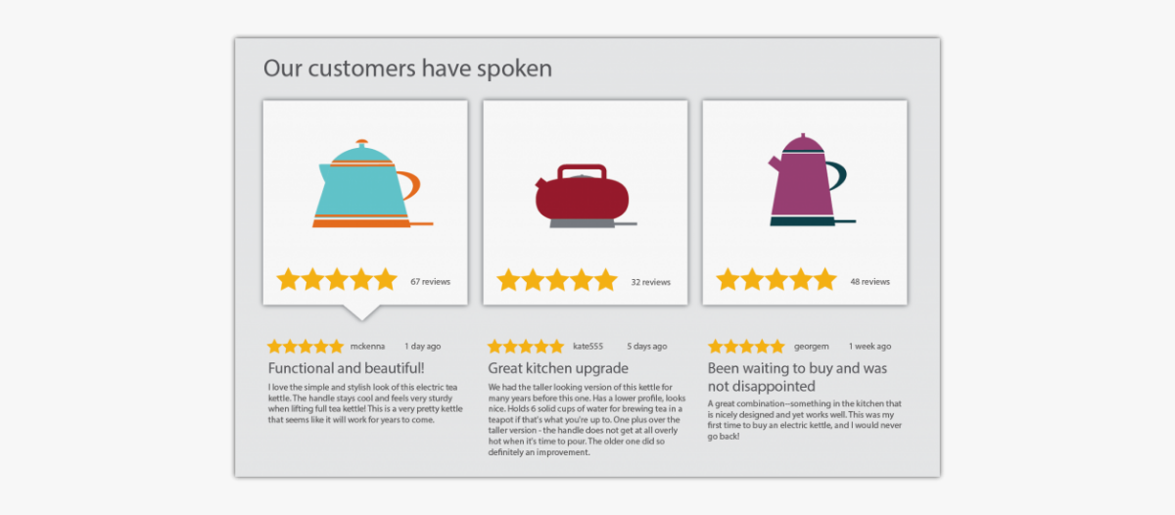
SYSTEM WORKFLOW DIAGRAM:
Raw Review Data
↓
Text Preprocessing
↓
Keyword & Pattern Matching Engine
↓
Negation + Rule Filtering
↓
Final Tag Assignment
↓
CSV/JSON Output + Dashboard Charts

Slide 14
EVALUATION:
Manual evaluation on 100 real reviews:
Metric Result
Precision ≥ 80%
Recall Based on dictionary coverage
Accuracy High for specific phrase-based tagging

Slide 15

ADVANTAGES:
. High precision
. No training data required
. Easy to customize for new tags
. Fast processing even for large datasets

Slide 16

LIMITATIONS:
. Can miss unexpected phrasing
(recall depends on dictionary)
. Negation handling is basic
. Cannot understand deep context
like ML-based models

Slide 17

APPLICATIONS:
.Customers experiences dashboards
.Quality monitoring
.Product improvement analysis
.Automated feedback categorization
.Business intelligence reporting

Slide 18

REFERENCES:
.NLP with spaCy Documentation
.Text Mining for Customer Feedback-
Research papers
.E-commerce domain sentiment analysis
publications

Slide 19
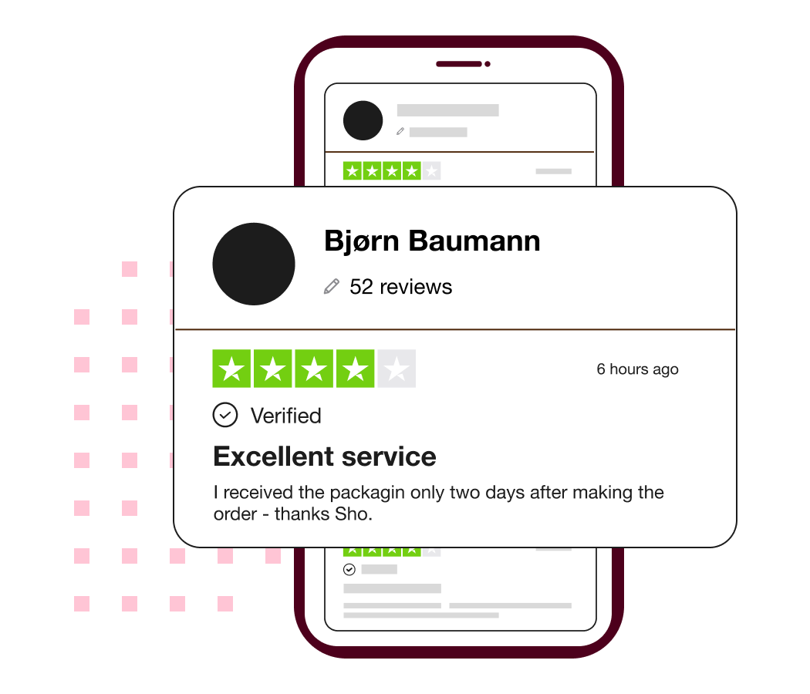
LITERATURE REVIEW:
Traditional sentiment analysis uses machine learning or deep learning models (Naive Bayes, SVM, LSTM, BERT).
However, rule-based NLP is still widely used
where:
.Training data is limited
.High precision is required
.Domain-specific phrase recognition matters
Techniques referenced:
.Rule-based Named Entity Recognition (NER)
.Pattern Matching
.Keyword and Phrase Matching
.Negation Handling
.Regular Expression-based extraction
Tools: Regex, spaCy PhraseMatcher, Tokenization, POS/Dependency parsing

Slide 20
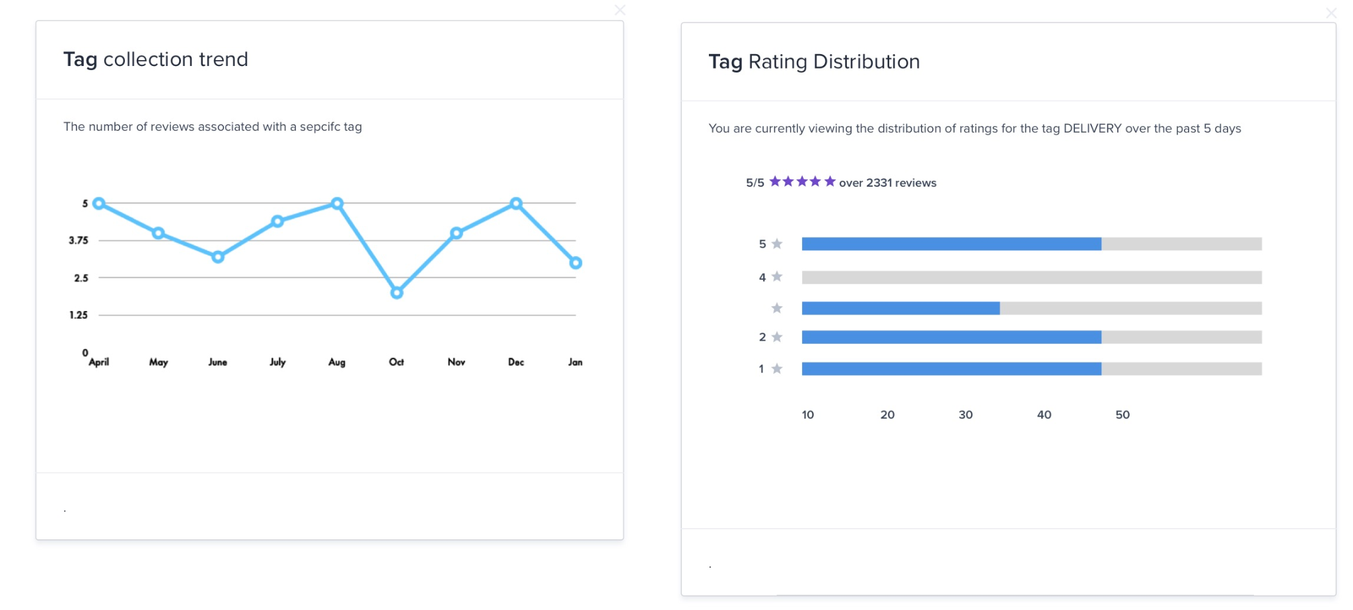
FUTURE ENHANCEMENTS:
.Add sentiment polarity detection (positive/negative)
.Hybrid approach combining rules + ML
.Support for multi-language review text
(Hindi/Hinglish)
.Advanced dependency-based
negation and context modeling

Slide 21
RESULT & DISCUSSION:
.Sample outputs of tagged reviews
.Observation & insights about customer
feedback
.Tag frequency chart and
dashboard

Slide 22
DELIVERABLES:
S.No Deliverable Description
1 Project Report Full documentation
2 Python Code Tagging pipeline .py file
3 Dataset Product review sample dataset
4 Output file Tagged results (CSV)
5 Presentation PPT with findings

Slide 23
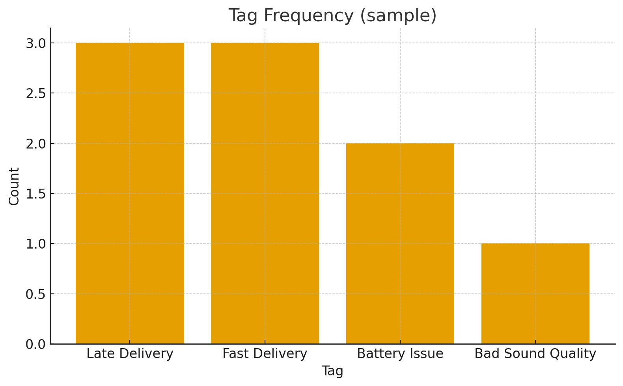
CONCLUSION:
.Summary of achievements
.Importance of automated review insights for business
improvement

Slide 24
Thank You!

